Slide 1


Slide 2

Combining Belief & Desire
Basis of Utility Theory
Utility Functions.
Multi-attribute Utility Functions.
Decision Networks
Value of Information
Expert Systems

Slide 3

Rational Decision
  Based on Belief & Desire
  Where uncertainty & conflicting goals exist
Utility
  assigned single number by some Fn.
  express the desirability of a state
  combined with outcome prob.
  expected utility for each action

Slide 4

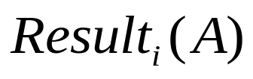
Notation
  U(S) : utility of state S
  S : snapshot of the world
  A : action of the agent
  : outcome state by doing A
  E : available evidence
  Do(A) : executing A in current S

Slide 5
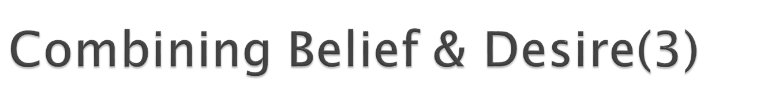
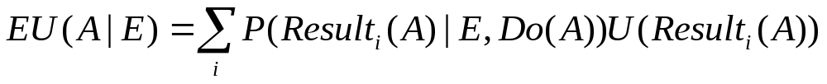
Expected Utility
Maximum Expected Utility(MEU)
  Choose an action which maximizes agent’s expected utility

Slide 6


Rational preference
  Preference of rational agent
  obey constraints
  Behavior is describable as maximization of expected utility

Slide 7




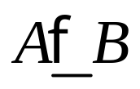
Notation
  Lottery(L): a complex decision making scenario
    Different outcomes are determined by chance.
  : A is preferred to B
  : indifference btw. A & B
  : B is not preferred to A

Slide 8

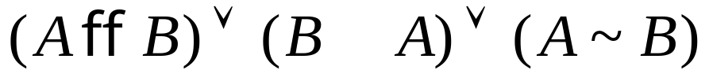
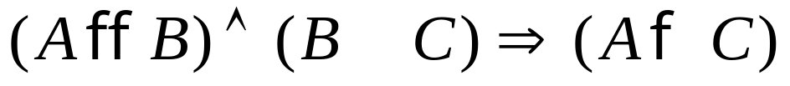
Constraints
  Orderability
  Transitivity
  Continuity

Slide 9


Constraints (cont.)
  Substitutability
  Monotonicity
  Decomposability

Slide 10


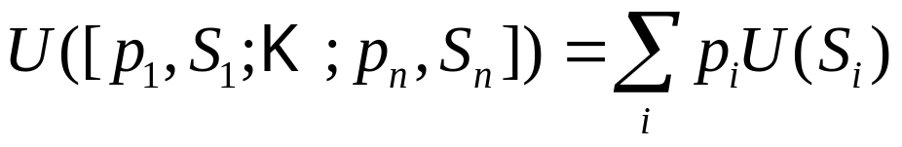

Utility principle
Maximum Expected Utility principle
Utility
  Represents that the agent’s actions are trying to achieve.
  Can be constructed by observing agent’s preferences.

Slide 11



Utility
  mapping state to real numbers
  approach
    Compare A to standard lottery
      u : best possible prize with prob. p
      u : worst possible catastrophe with prob. 1-p
    Adjust p until
    eg) $30 ~ L
0.9
continue
0.1
death

Slide 12

Utility scales
  positive linear transform
  Normalized utility
  u = 1.0, u = 0.0
  Micromort (“微死亡”)
  one-millionth chance of death
    Russian roulette, insurance
  QALY
  quality-adjusted life years

Slide 13

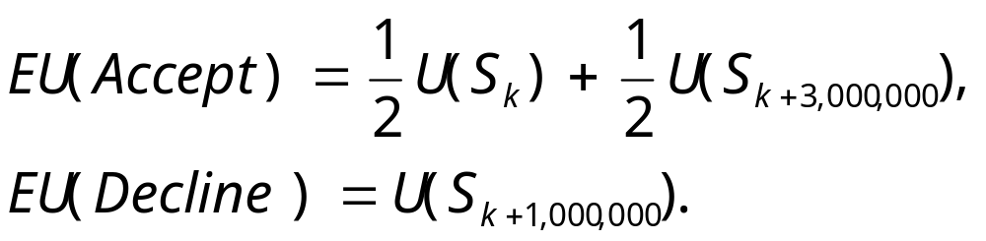
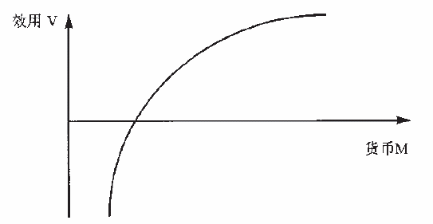
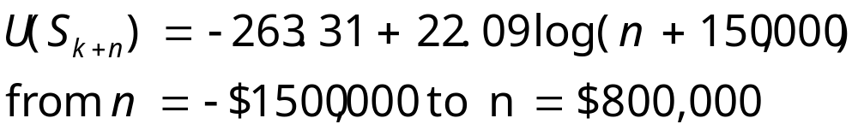
Utility of Money
  TV game
    1million vs 3 millions by chance 0.5
Example (Grayson, 1960)

Slide 14



Money : does NOT behave as a utility fn.
  Given a lottery L
  risk-averse (不愿承担风险)
  risk-seeking (风险追求)
U
0
$

Slide 15
Combining Belief & Desire
Basis of Utility Theory
Utility Functions
Multi-attribute Utility Functions
Decision Networks
Value of Information
Expert Systems

Slide 16
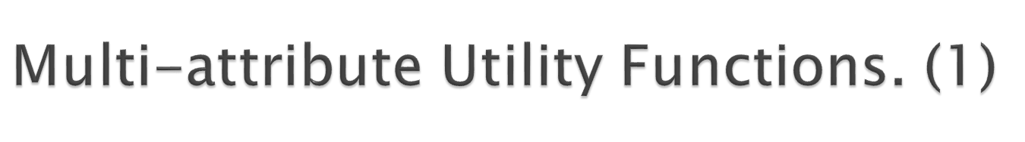
Multi-Attribute Utility Theory (MAUT)
  Outcomes are characterized by 2 or more attributes.
  eg) Site a new airport
    disruption by construction, cost of land, noise,….
Approach
  Identify regularities in the preference behavior

Slide 17
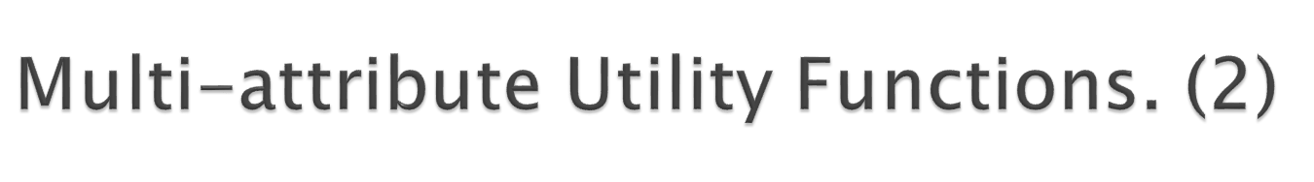
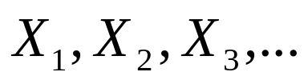

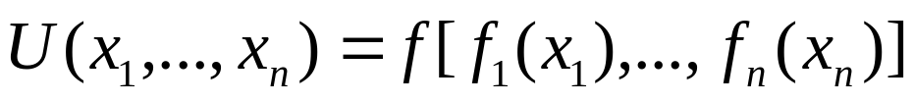
Notation
  Attributes
  Attribute value vector
  Utility Fn.

Slide 18
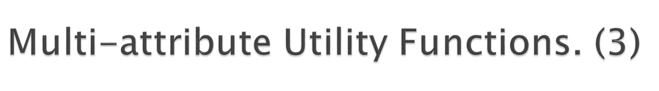
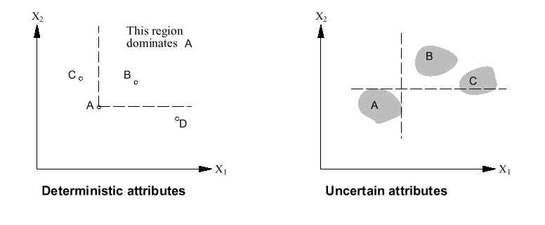
Dominance
  Certain (strict dominance, Fig.1)
    eg) airport site S1 cost less, less noise, safer than S2
    : strict dominance of S1 over S2
  Uncertain(Fig. 2)
Fig. 1 Fig.2

Slide 19
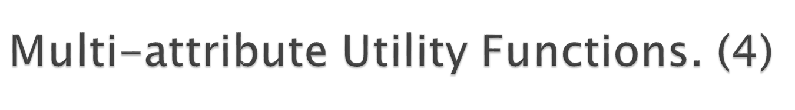
Dominance(cont.)
  stochastic dominance
    In real world problem
    eg) S1 : avg $3.7billion,
    standard deviation : $0.4billion
    S2 : avg $4.0billion,
    standard deviation : $0.35billion
      S1 stochastically dominates S2

Slide 20

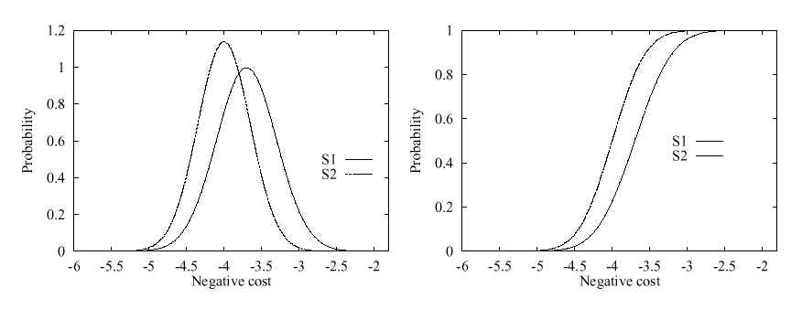
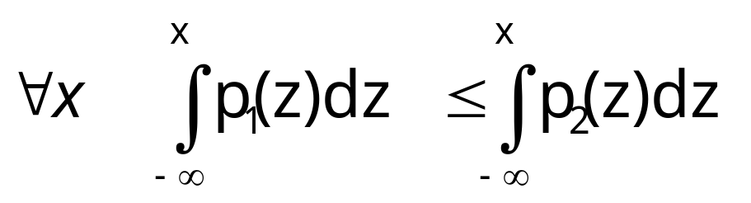
Dominance(cont.)

Slide 21



Preferences without Uncertainty
  preferences btw. concrete outcome values.
  Preference structure
    X1 & X2 preferentially independent of X3 iff
    Preference btw.
    Does not depend on
    eg) Airport site : <Noise,Cost,Safety>
    <20,000 suffer, $4.6billion, 0.06deaths/mpm>
    vs.
    <70,000 suffer, $4.2billion, 0.06deaths/mpm>

Slide 22
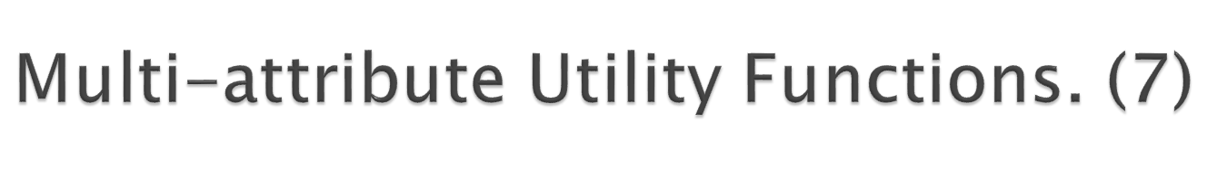
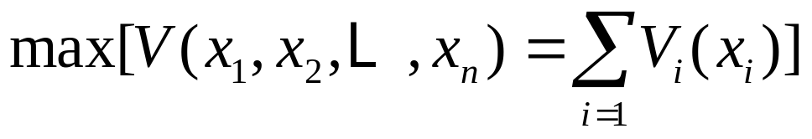
Preferences without Uncertainty(cont.)
  Mutual preferential independence(MPI)
    every pair of attributes is P.I of its complements.
    eg) Airport site : <Noise, Cost, Safety>
      Noise & Cost P.I Safety
      Noise & Safety P.I Cost
      Cost & Safety P.I Noise
      : <Noise,Cost,Safety> exhibits MPI
    Agent’s preference behavior

Slide 23
Preferences without Uncertainty(cont.)
  Mutual preferential independence(MPI)
    Airport site selection
    <Noise,Cost,Safety> exhibits MPI
    Agent’s preference behavior

Slide 24
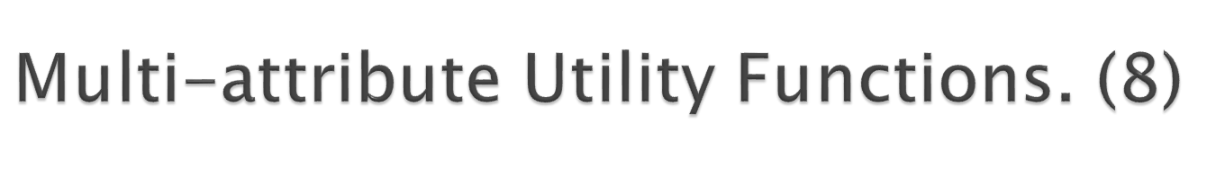
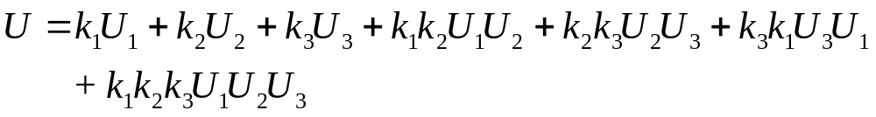
Preferences with Uncertainty
  Preferences btw. Lotteries’ utility
  Utility Independence(U.I)
    X is utility-independent of Y iff preferences over lotteries’ attribute set X do not depend on particular values of a set of attribute Y.
  Mutual U.I. (MUI)
    Each subset of attributes is U.I of the remaining attributes.
    agent’s behavior( for 3 attributes) :multiplicative Utility Fn.

Slide 25

Simple formalism for expressing & solving decision problem
Belief networks + decision & utility nodes
Nodes
  Chance nodes
  Decision nodes
  Utility nodes

Slide 26

Decision node
Airport Site
utility table
Air Traffic
Death
U
litigation
Noise
诉讼
Cost
Construction
Utility node
CPT

Slide 27

Airport Site
Action-utility table
Air Traffic
U
litigation
Construction

Slide 28

Function DN-eval (percept) returns action
static D, a decision network
  set evidence variables for the current state
  for each possible value of decision node
    set decision node to that value
    calculate Posterior Prob. For parent nodes of the utility node
    calculate resulting utility for the action
  select the action with the highest utility
return action

Slide 29

Idea
  Compute value of acquiring each of evidence
Example : Buying oil drilling rights
  Three blocks A,B and C, exactly one has oil, worth k dollars
  Prior probabilities 1/3 each, mutually exclusive
  Current price of each block is k/3
  Consultant offers accurate survey of A. Fair price?

Slide 30

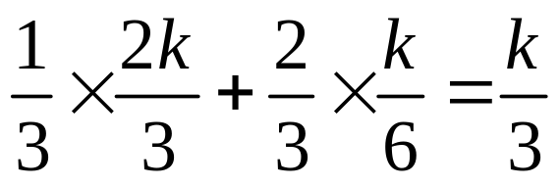
Solution: Compute expected value of Information
  = Expected value of best action given information
  - Expected value of best action without information
Survey may say “oil in A” with pdf 1/3or ‘no oil in A”( 2/3)
  With pdf 1/3, A has oil
  profit: k-k/3=2k/3
  With pdf 2/3, A has no oil
  Profit: k/2-k/3=k/6
  EV =

Slide 31

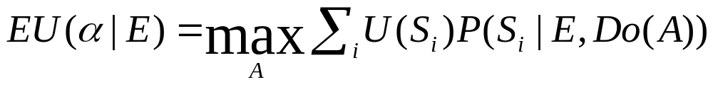
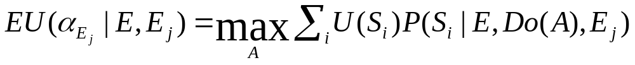
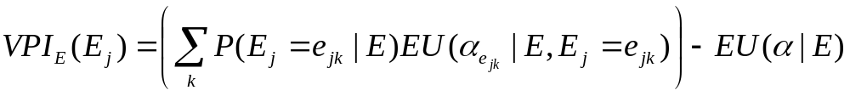
Notation
  Current evidence E, Current best action α
  Possible action outcomes Result_{i}(A)=S_{i}
  Potential new evidence E_{j}
Value of perfect information (VPI)

Slide 32
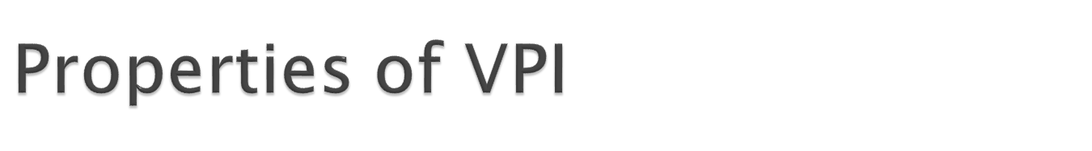


Nonnegative
Nonadditive
Order-Independent

Slide 33

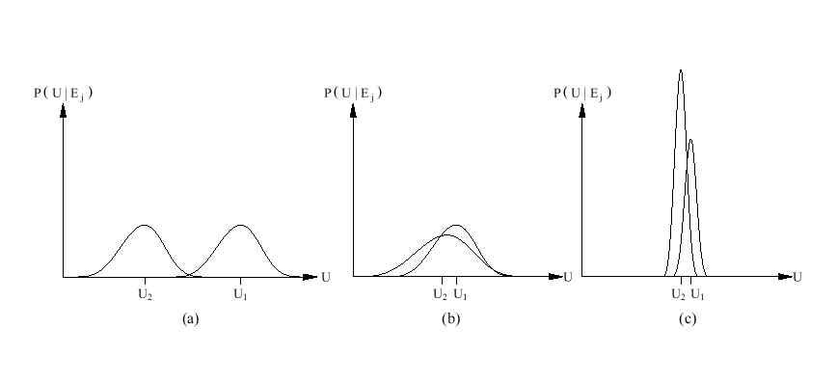
  a) Choice is obvious, information worth little
  b) Choice is nonobvious, information worth a lot
  c) Choice is nonobvious, information worth little

Slide 34
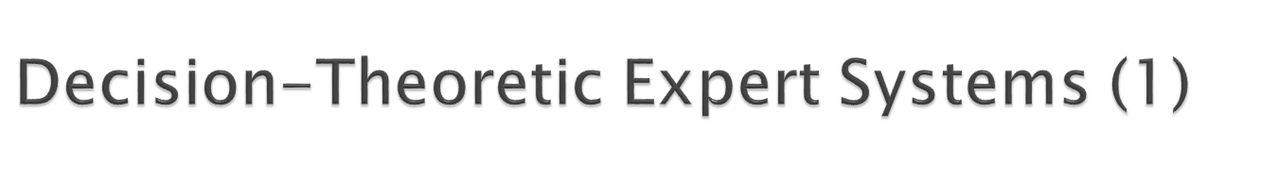
Decision analysis
  Decision maker
    States Preferences between outcomes
  Decision analyst
    Enumerate possible actions & outcomes
    Elicit preferences from decision maker to determine the best course of action
Advantage
  Reflect preferences of the user, not system
  Avoid confusing likelihood and importance

Slide 35
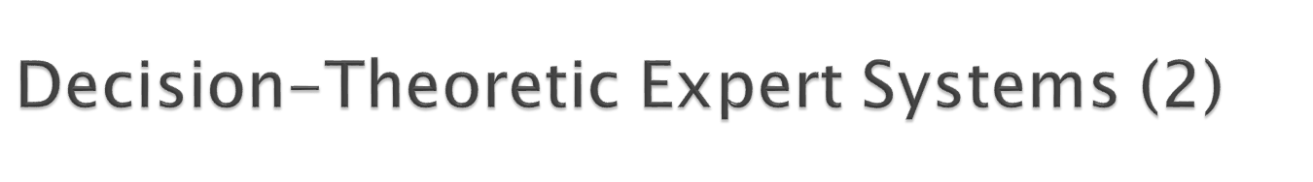
Determine the scope of the problem
Lay out the topology
Assign probabilities
Assign utilities
Enter available evidence
Evaluate the diagram
Obtain new evidence
Perform sensitivity Analysis

Slide 36

Combining Belief & Desire
Basis of Utility Theory
Utility Functions.
Multi-attribute Utility Functions.
Decision Networks
Value of Information
Expert Systems

Slide 37


